Slide 1






Vulnerability Assessment
and
Remediation Plan
OCT- 2024

Slide 2





Mina Maximous
Mustafa Fayez
Ahmed Abobakr
Ibrahim Ahmed
, , ,
Meet Our Team

Slide 3


Introducing Our
Project
Vulnerability Assessment and Remediation Plan
Cybersecurity isn't just about responding to incidents; it's about proactively identifying and addressing vulnerabilities before they can be exploited. In this project, I carried out a comprehensive vulnerability assessment and remediation plan aimed at securing network systems and applications. Over a four-week period, I evaluated security gaps, tested potential attack vectors, and developed a secure configuration and patch management strategy to mitigate risks. This project demonstrates how a structured approach to vulnerability management can significantly enhance the security posture of an organization

Slide 4
Our Plan
Our project follows a four-week approach to improve security. First, we conduct a vulnerability assessment to identify risks. Next, we perform penetration testing to evaluate vulnerabilities. In week three, we implement secure configurations and patch management. Finally, we compile our findings and remediation strategies into a final report and presentation
WEEK 1
Vulnerability Assessment
WEEK 2
Penetration Testing
WEEK 3
Secure Configuration & Patch Management
Perform a thorough scan of network, systems, and applications to identify potential vulnerabilities. Document and assess the risks associated with each finding
Simulate attacks on identified vulnerabilities to evaluate their exploitability. Provide a detailed report of the results and suggest remediation actions
Develop and implement security configurations and establish a patch management strategy to address discovered vulnerabilities and enhance system security

Slide 5

TOOLs WE USED
Used to create virtual machines, allowing us to simulate and isolate multiple environments for testing without affecting the actual systems
VMware
A network emulation tool that enabled us to design and test complex network scenarios and configurations in a virtualized environment
EVE
A security-focused operating system packed with penetration testing tools. It was essential for conducting vulnerability assessments and penetration testing
KALI LINUX
A deliberately vulnerable virtual machine used to safely practice penetration testing, helping to identify security flaws and assess the effectiveness of remediation
METASPLOITABLE

Slide 6
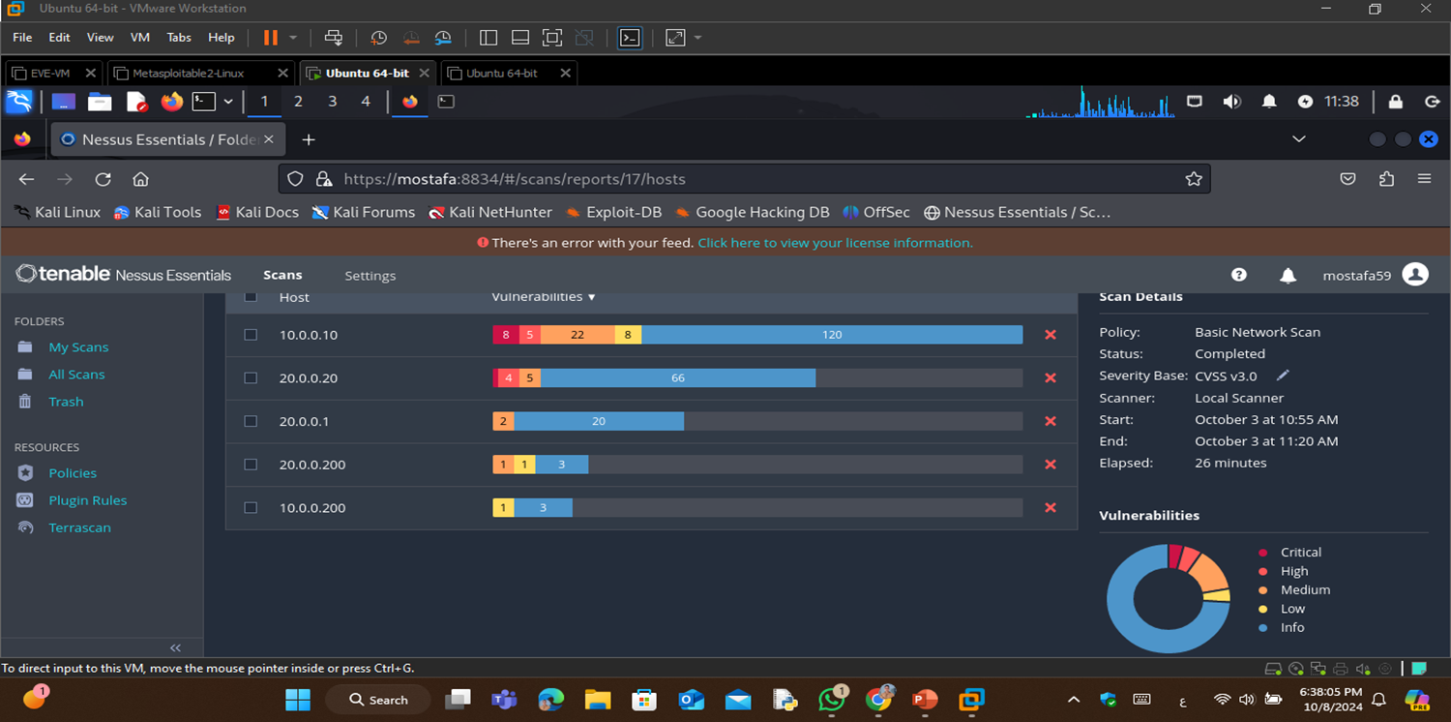


WEEK 1
In the first week, we initiated the vulnerability assessment process by setting up the network environment. This included configuring both the vulnerable machine and the Kali Linux machine for penetration testing. The network consists of a vulnerable machine with IP 10.0.0.10/24 connected to Router R1 through interface e0/0, and a Kali Linux machine used to scan the network.
Using tools like Nessus, we conducted a preliminary scan to identify critical vulnerabilities. The focus was on the following:
Vulnerable Machine (IP: 10.0.0.10)
The machine had several critical vulnerabilities, including remote code execution and injection flaws.
Apache PHP-CG
I Remote Code Execution
Apache Tomcat Ajp
Connector Request
Injection
Bind Shell
Backdoor Detection
Debian OpenSSH/OpenSSL Package Random Number Generator Weakness
Debian OpenSSH/OpenSSL Package Random Number Generator Weakness
Ssl Version 2 And 3 Protocol Detection

Slide 7
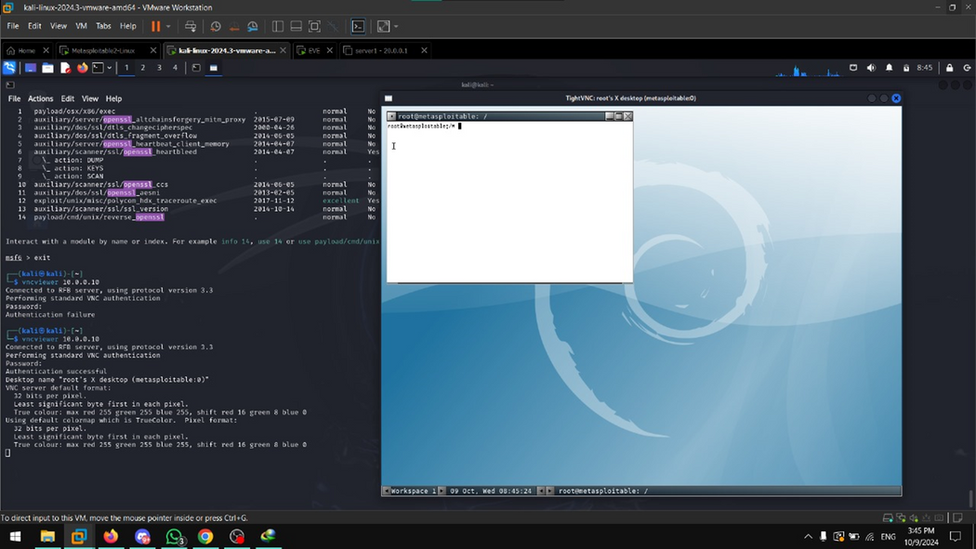
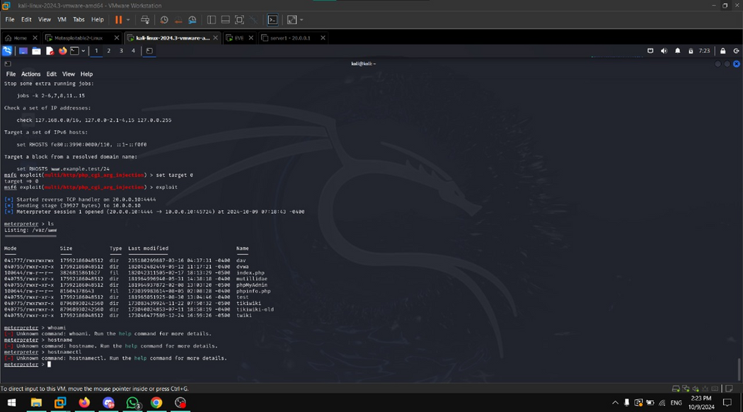
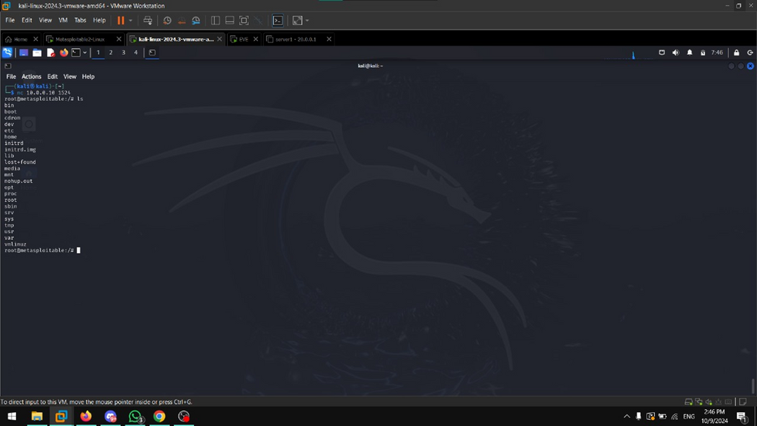

WEEK 2
we focused on validating and exploiting the most critical vulnerabilities identified during the vulnerability assessment. The network environment, including a vulnerable machine and a Kali Linux machine, was tested for weaknesses. Using penetration testing techniques, we successfully simulated real-world attacks to confirm the severity of the vulnerabilities.
Key vulnerabilities exploited included Apache PHP-CGI Remote Code Execution, Apache Tomcat AJP Connector Request Injection (Ghostcat), Debian OpenSSH/OpenSSL Random Number Generator Weakness, and phpMyAdmin SQL Injection. Each of these exploits demonstrated how attackers could gain unauthorized access, execute arbitrary code, or compromise sensitive data. The successful exploitation highlighted the potential risks these vulnerabilities pose and emphasized the importance of applying the recommended remediation strategies.
This week’s findings underscore the critical need for patching and securing the environment to prevent real-world attacks

Slide 8

The Vlun.
That We Have Exploit
01
NFS Shares World Readable
02
Apache Tomcat AJP
Connector Request Injection
The NFS Shares World Readable vulnerability occurs when the Network File System (NFS) shares are configured with overly permissive access
Allowing users to read the shared files. This can lead to
unauthorized data exposure and potentially compromise sensitiveinformation stored on the server.
we used Metasploit's auxiliary module for this attack:
Command: msf > use auxiliary/admin/http/tomcat_ghostcat
After setting the necessary options, we ran the exploit to read sensitive files from the server.
The exploitation demonstrated how an attacker could obtain configuration files or execute code, compromising the server
03
Samba Badblock Vulnerability
04
VNC Weak Password
Samba or SMB for short is a file sharing service that lets users access files and printer services in a network.
Using MSF6, the exploit exploit/multi/samba/usermap_script gains root access to Metasploitable 2.
Using SQL injection techniques, we crafted malicious SQL queries and injected them into vulnerable input fields in phpMyAdmin.
This enabled us to gain unauthorized access to database contents, demonstrating how attackers can modify or delete critical data.

Slide 9
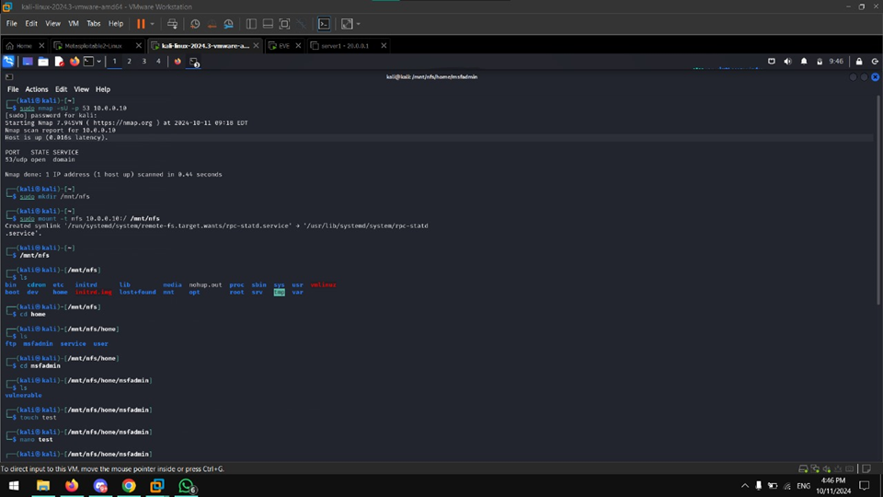
01
NFS Shares World Readable

Slide 10

02
Apache Tomcat AJP
Connector Request Injection

Slide 11
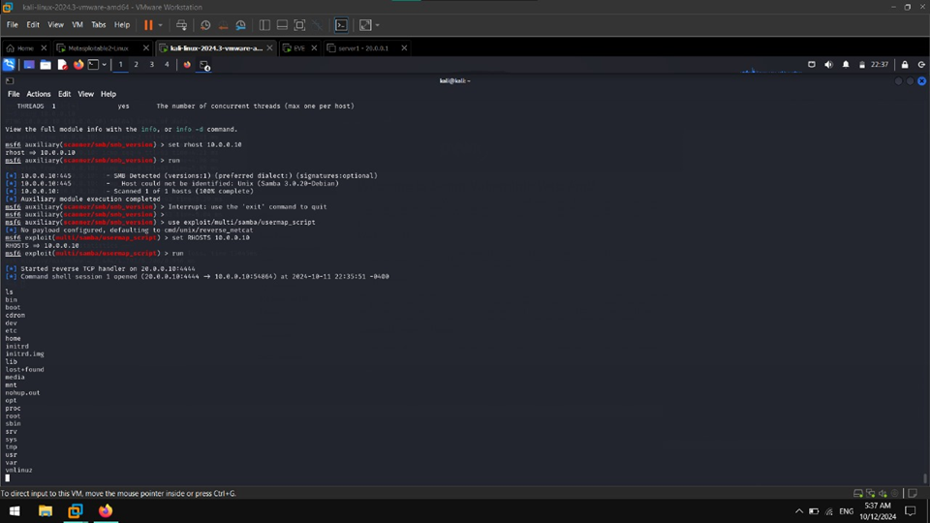
03
Samba Badblock Vulnerability

Slide 12

04
VNC Weak Password
Apache Tomcat AJP
Connector Request Injection

Slide 13
WEEK 3
For this week’s project on Secure Configuration and Patch Management, we identified and remediated several vulnerabilities in Metasploitable , focusing on improving system security through proper configurations and timely patches. Below is a summary of the vulnerabilities and their remediation strategies:
NFS Misconfiguration
VNC
Weak Password
Samba (SMB) Exploit
Apache Tomcat Ghostcat Vulnerability
Limit access to the NFS directories by restricting it to necessary hosts and directories in the NFS configuration file (/etc/exports). Only allow access to specific IP addresses or hostnames that require access
Change the VNC password using the vncpasswd command to set a strong, secure password that reduces the risk of unauthorized access
Modify the Samba configuration file by commenting out or removing the line username map script = "/etc/samba/scripts/mapusers.sh". This disables the script that could be exploited for privilege escalation
Apply the appropriate patch by updating Apache Tomcat to a secure version. Additionally, modify the Tomcat configuration file (/etc/tomcat5.5/server.xml) to add an authentication layer for the AJP connector, ensuring only authorized access
01
02
03
04

Slide 14

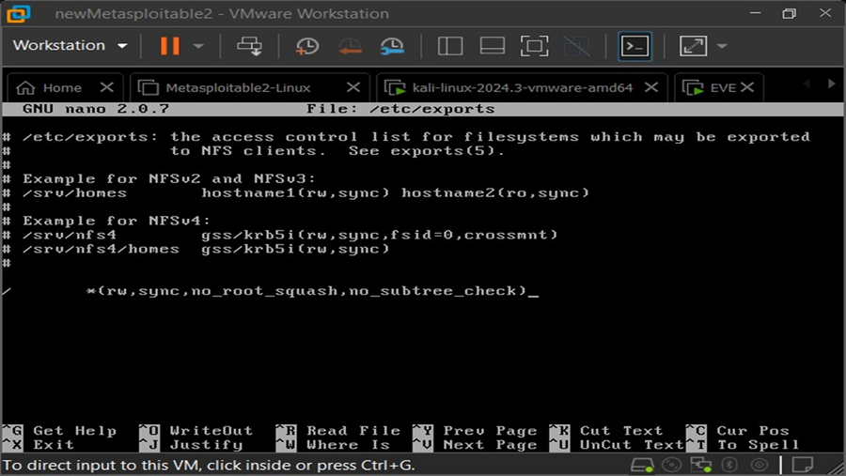
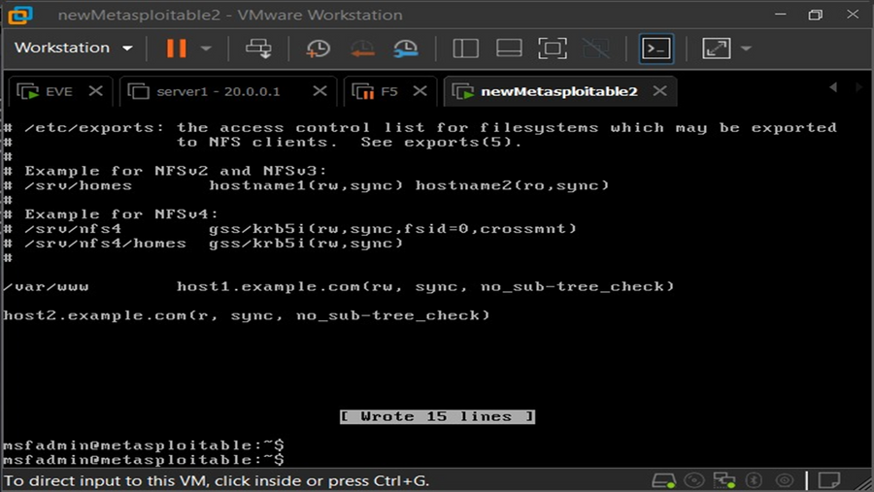
1
NFS Misconfiguration
Port 2049 (NFS):
- Handles the actual file sharing and data transmission between the client and server.
In Metasploitable 2,
NFS is misconfigured so that it provides full access to its entire root
filesystem to all devices on the network. As you can see from
”/etc/exports”
down below, means that all hosts are allowed to mount the root
filesystem which is ill-advised. It is considered best practice to limit
access to only necessary hosts and restrict to only necessary
directories.

Slide 15
2
VNC Weak Password
The VNC password for Metasploitable 2 is “password” funnily enough which makes it very easy to brute-force. The VNC password should be changed by using the command vncpasswd.
01
04

Slide 16
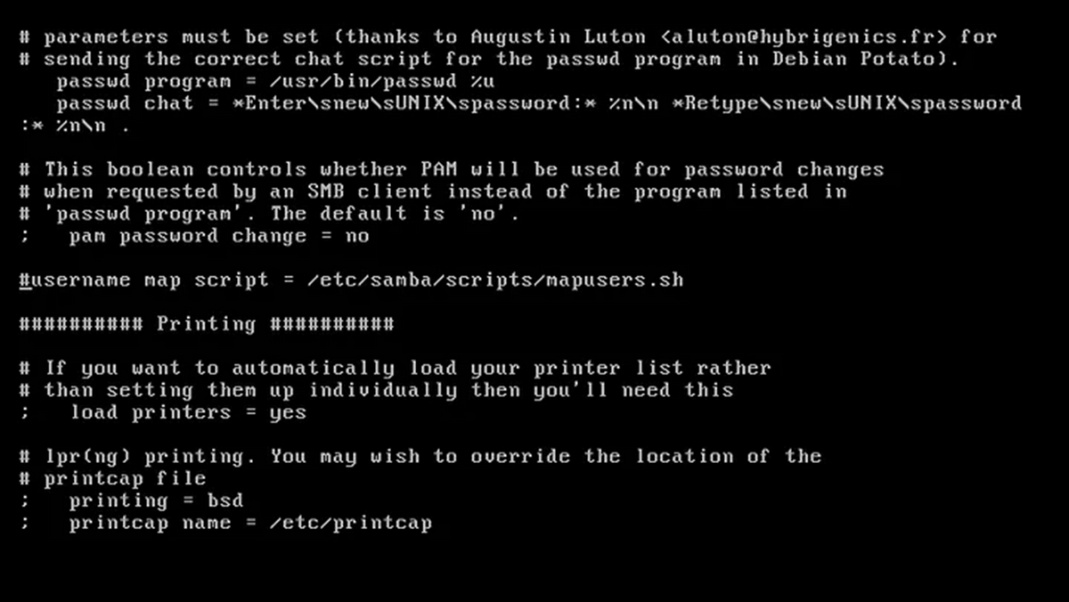
3
Samba (SMB) Exploit
Samba or SMB for short is a file sharing service that lets users access files and printer
services in a network. Using MSF6, the exploit exploit/multi/samba/usermap_script gains
root access to Metasploitable 2.The exploit can be rendered useless if the line username
map script =
“/etc/samba/scripts/mapusers.sh”
is commented.

Slide 17
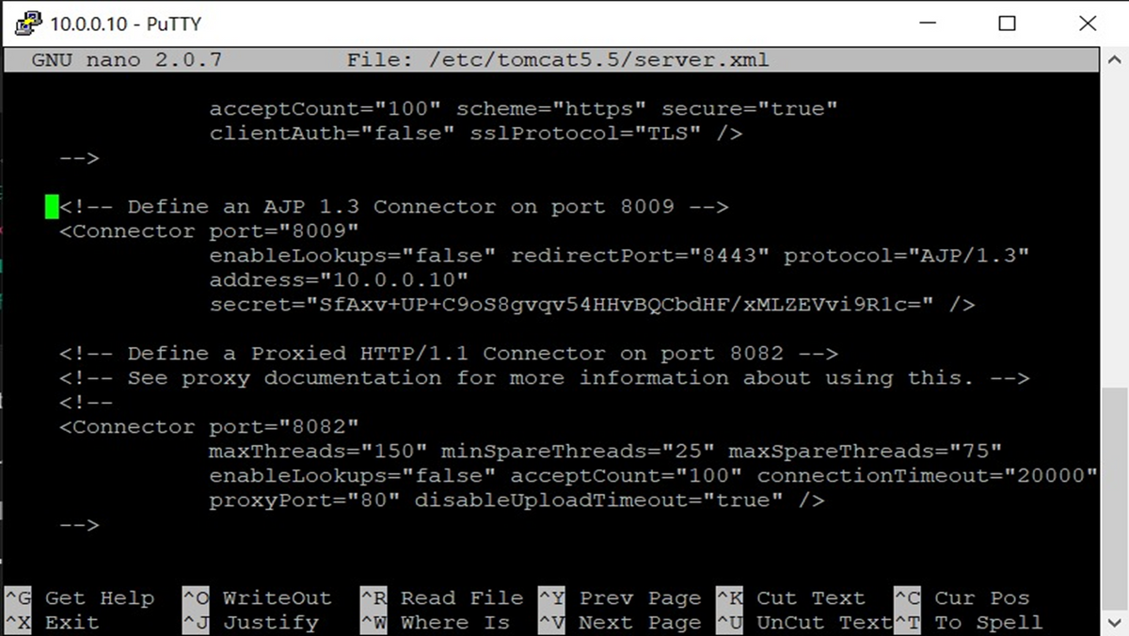
4
Apache Tomcat
Ghostcat Vulnerability
The AJP Connector facilitates communication between Tomcat and the installed web server which in this
case is Apache. Its similar to that of a load balancer as it offload static rendering of web pages to the web
server while directing dynamic java processing to Tomcat. This particular version of Tomcat installed on
Metasploitable 2 is running a vulnerable AJP Connector. The Ghostcat vulnerability (CVE-2020–1938)
allows an attacker to retrieve all files in the web application that can be reached with
“ServletContext.getResourceAsStream()”.
It also allows the attacker to process any file as JSP which coupled with remote file upload could lead to
remote code execution. This vulnerability can be remediated by adding the following line to
“/etc/tomcat5.5/server.xml ”
which provides a layer of authentication.
01
04

Slide 18

Thank you for your presence and focus
OCT- 2024

